Slide 1


06 Interpreting Ecological Niche Modeling
Shelly Gaynor
University of Florida

Slide 2
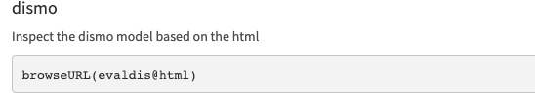
06 Continued
View an html output for models made with dismo

Slide 3
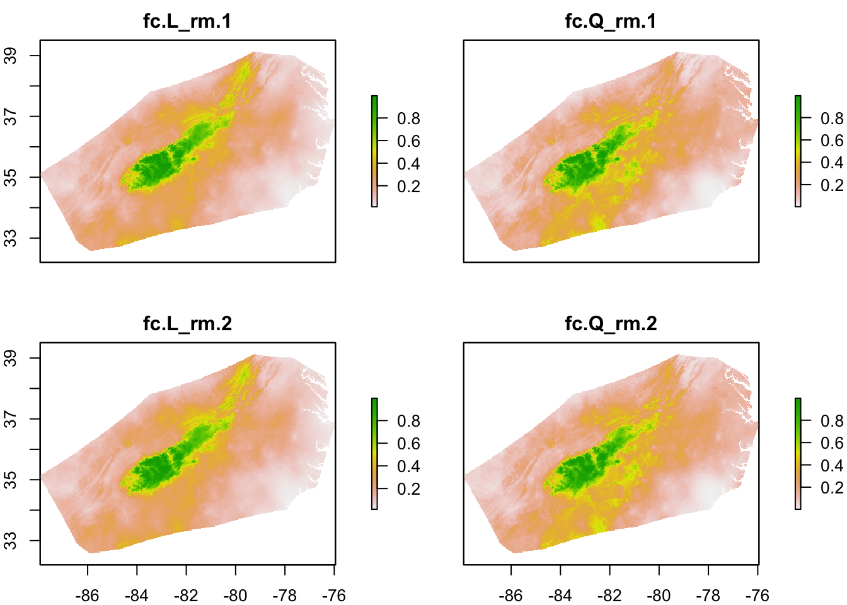
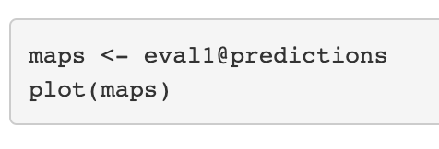
ENMeval – Visualize

Slide 4
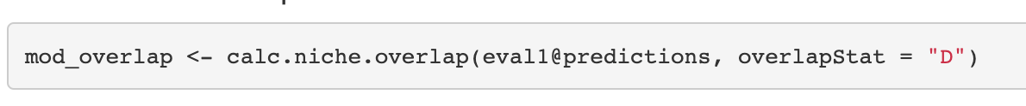
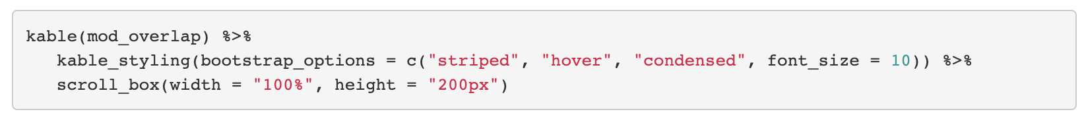
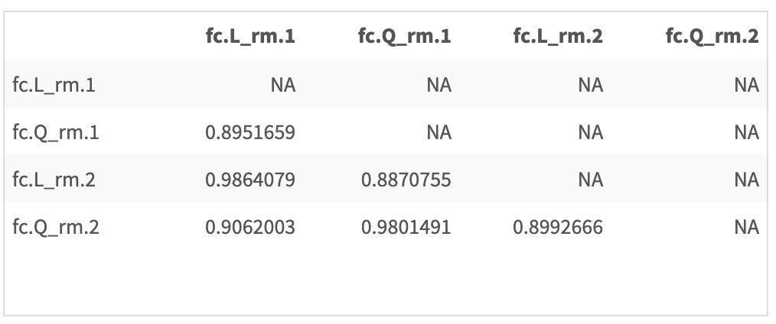
ENMeval – Model Overlap

Slide 5
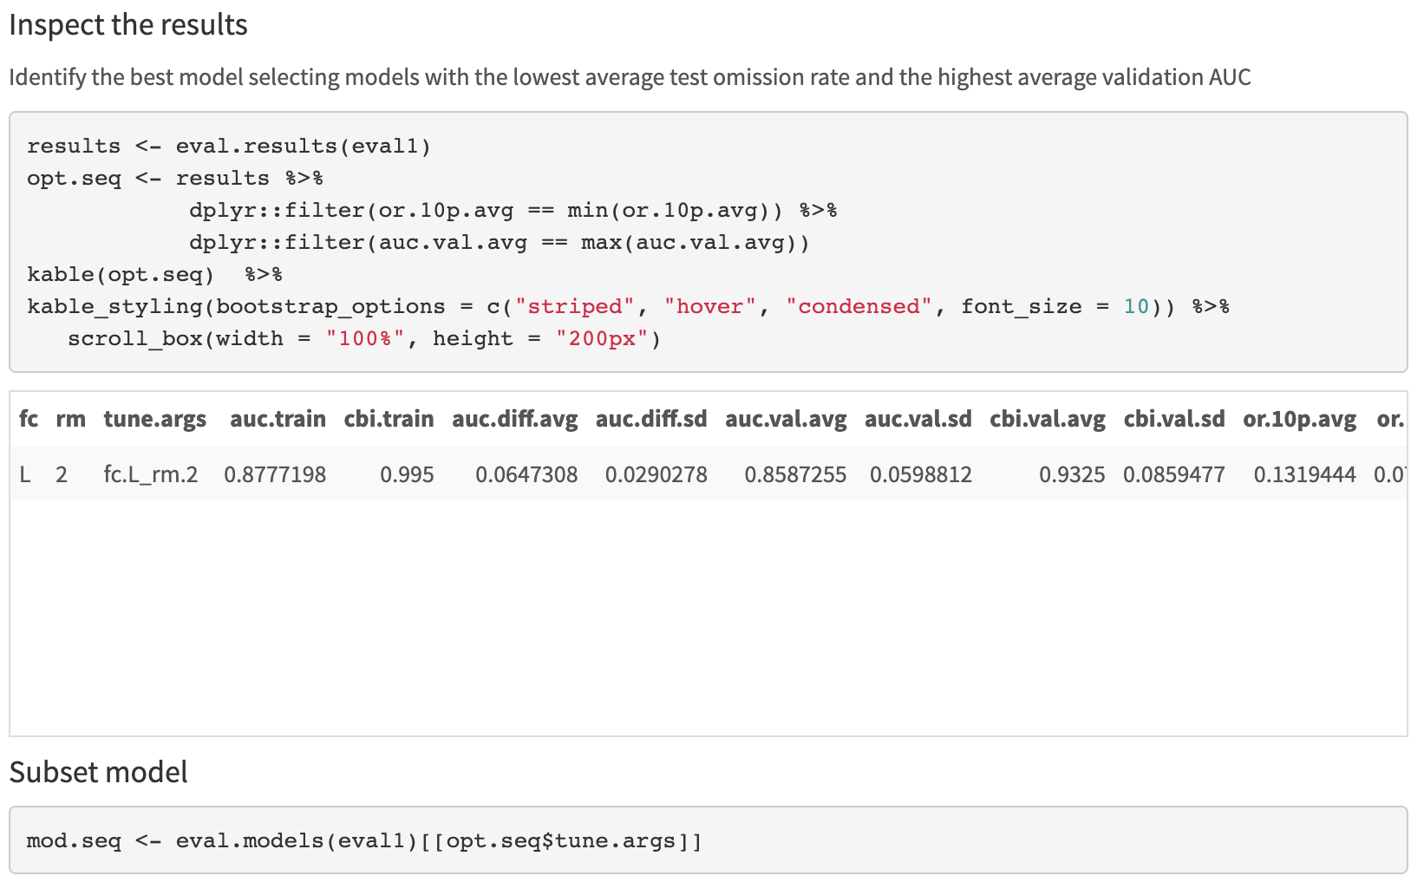
ENMeval – Select Best Model

Slide 6
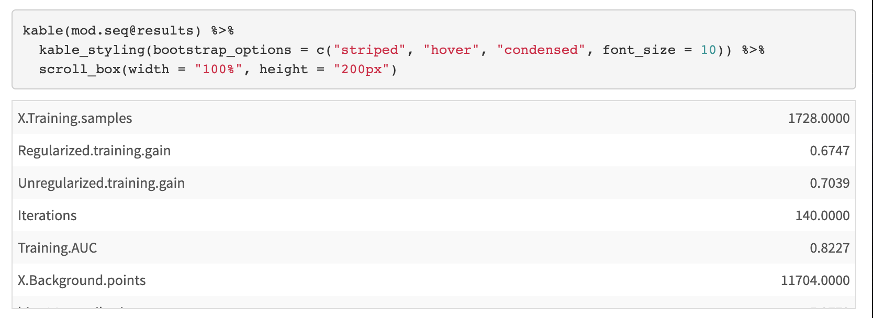
ENMeval – Inspect

Slide 7
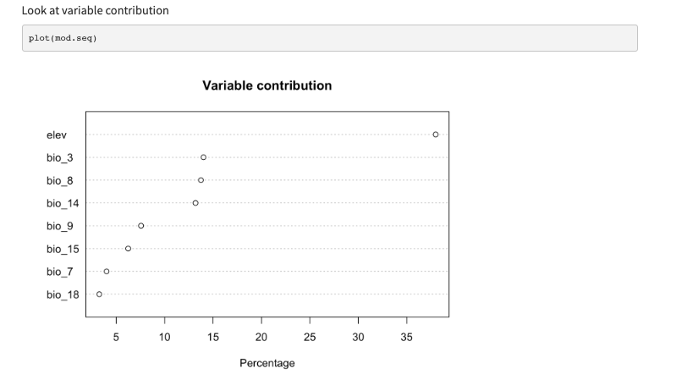
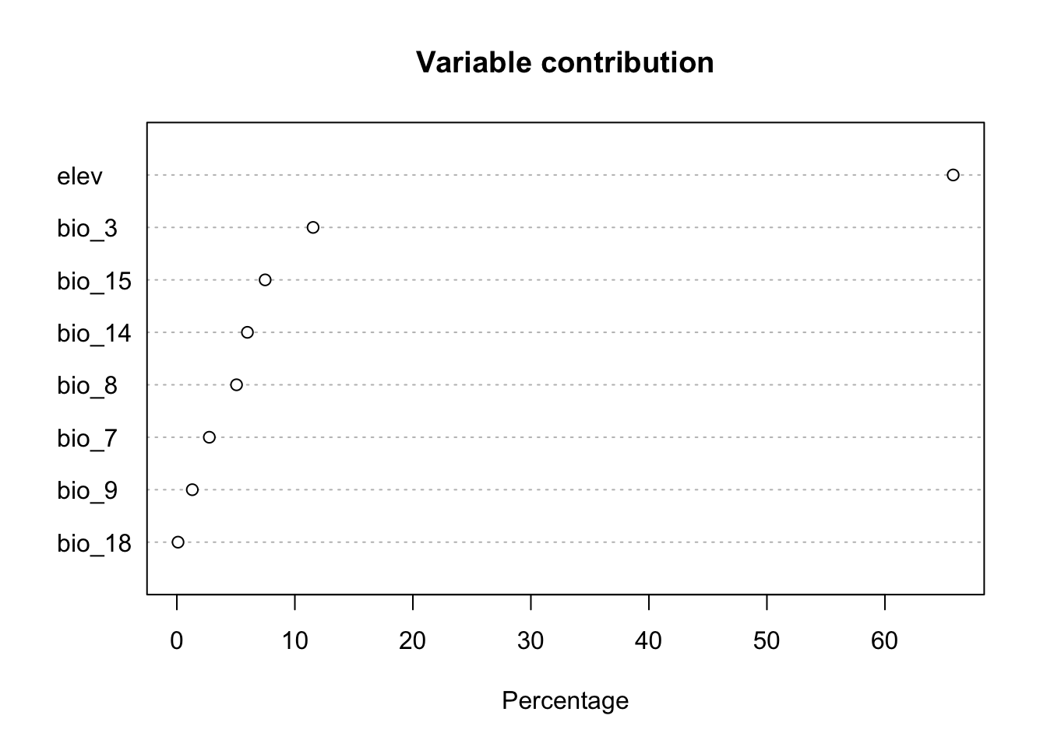
ENMeval – Variable Contribution

Slide 8
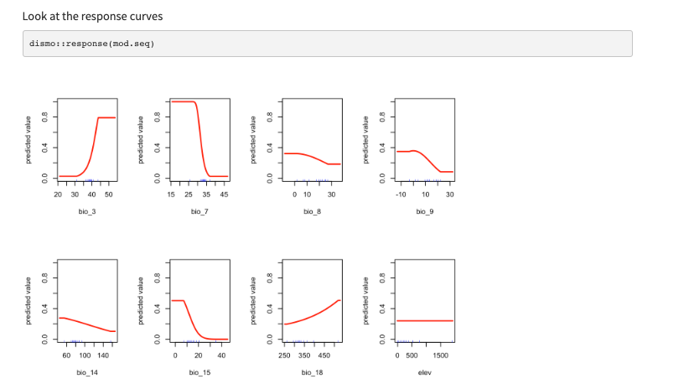
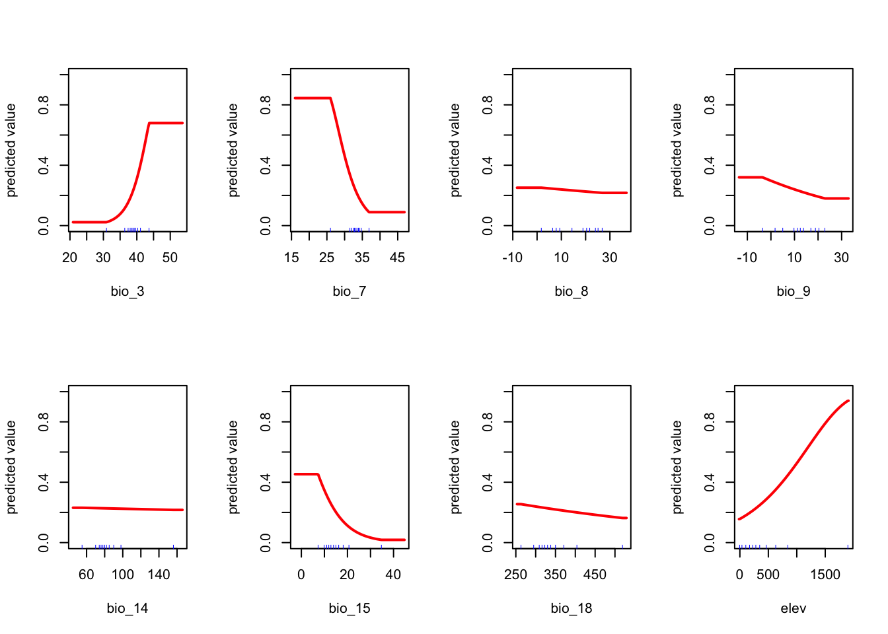
ENMeval – Response curves

Slide 9
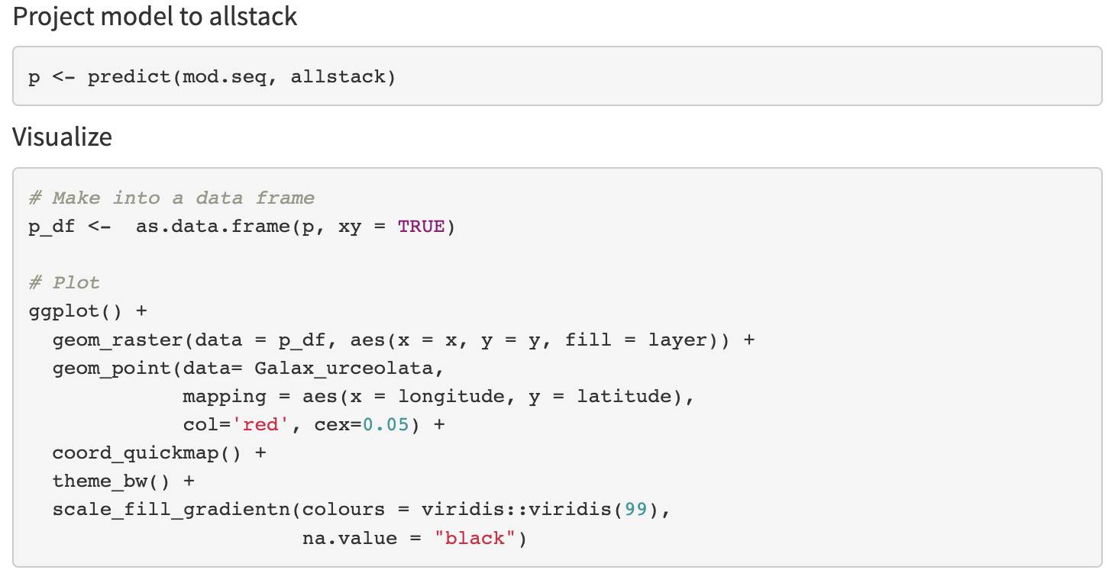
ENMeval – Project and Plot

Slide 10
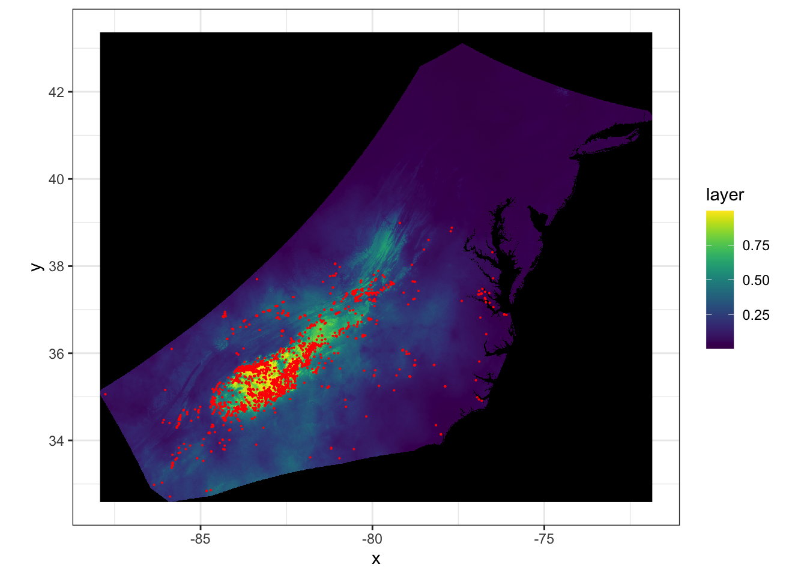

Slide 11
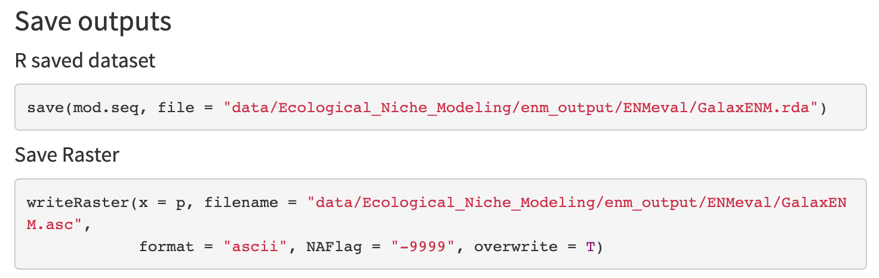
ENMeval – Save Model

Slide 12
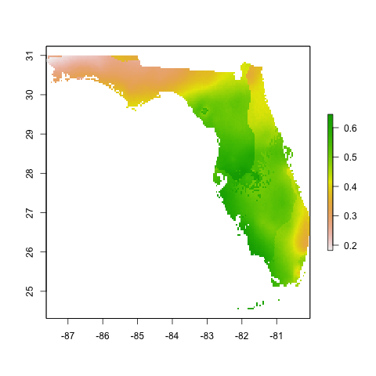
Interpreting ENMs
Step 1: Look at the output
Step 2: Evaluate the models
Step 3: Additional Analysis

